Slide 1
Nerd Block Group Case
By: Stormweaver Interactive
Ryan Schuette, Shawn Matthews, Daniel Munusami, Alex Donnelly

Slide 2
Introduction
Mission Statement
We have been hired by Nerd Block to create a new and improved database that efficiently stores critical information, is easily accessible by employees and useful for creating reports and data sets for this rapidly growing company.
Requirements Gathering
We looked at the existing system, and analyzed their requirements to create a list that this application needs

Slide 3

What is Nerd Block?
Geek Tested Nerd Approved!
A box subscription Service
Gaming and other nerdy items
Many different Styles

Slide 4
Nerd Block System Deficiencies
Overwhelmed by amount of new customers
Database quickly was overloaded
Database wasn’t easily accessible by employees
Couldn’t track transactions surrounding the business

Slide 5
Project Management
Originally this project started off as web based application using the Laravel Framework
We quickly realized that by using Laravel we wouldn’t be able to interact with the data based like we hoped, so it was decided that we needed to change our plan of action
We then switched to .NET development, and unfortunately we had to start from scratch
Our lead of the front end team Ryan Diplock left the project team

Slide 6
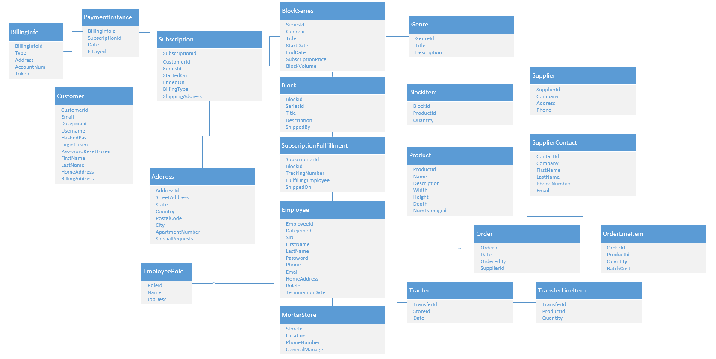
Database Design

Slide 7
Technologies Chosen
.NET with C#
.NET has a reflection system that lets us build highly extendible and highly upgradeable application.
Postgres Database Connection
We chose this database because it is free and enterprise grade which is not easy to come by.

Slide 8
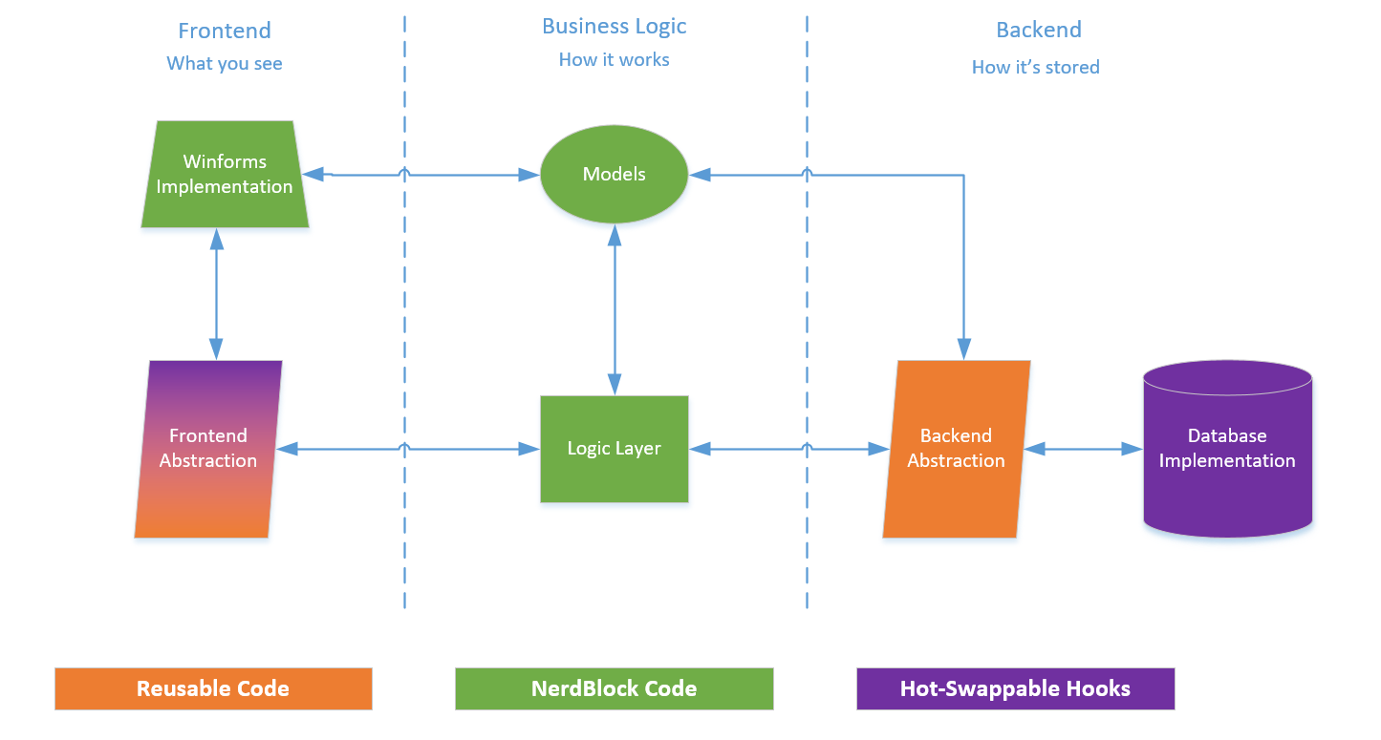
Application Design

Slide 9
Demo / Conclusion
As of this moment, our application is in its Beta
We have many ideas to extend it further and make it much more functional to provide ease of use along with speed and efficiency

Slide 10
The End
Thank you for listening

